Slide 1

Fundamentals of Economics
M.M.L.C.Gunathilake
Senior Lecturer Gr II
Department of Management and Finance
General Sir John Kotelawala Defence University
Ratmalana

Slide 2
The Macroeconomic Framework and Economic growth

Slide 3

What is macroeconomics?

Slide 4
What is macroeconomics?
Macroeconomics considers the performance of the economy as a whole.
We try to understand changes in
  The rate of economic growth
  The rate of inflation
  Unemployment
  Our trade performance with other countries
Macroeconomics also includes an evaluation of the relative success or failure of government economic policies
Notes:
The economy is made up of four sectors sometimes called economic agents:
Households who receive payments (income) for their services (eg labour and land) and use this money to buy the output of firms (ie consumption or household spending).
Firms who use land labour and capital to produce goods and services for which they pay wages rent etc (income) and receive payment (expenditure)
Government (also known as the public or state sector) and
International eg consumers buying overseas products (M) and Foreigners buying UK products (X)

Slide 5
So what is ‘the economy’?
The economy is made up of four sectors sometimes called economic agents:
Households who receive payments (income) for their services (eg labour and land) and use this money to buy the output of firms (ie consumption or household spending).
Firms who use land labour and capital to produce goods and services for which they pay wages rent etc (income) and receive payment (expenditure)
Government (also known as the public or state sector) and
International eg consumers buying overseas products (M) and Foreigners buying SL products (X)

Slide 6
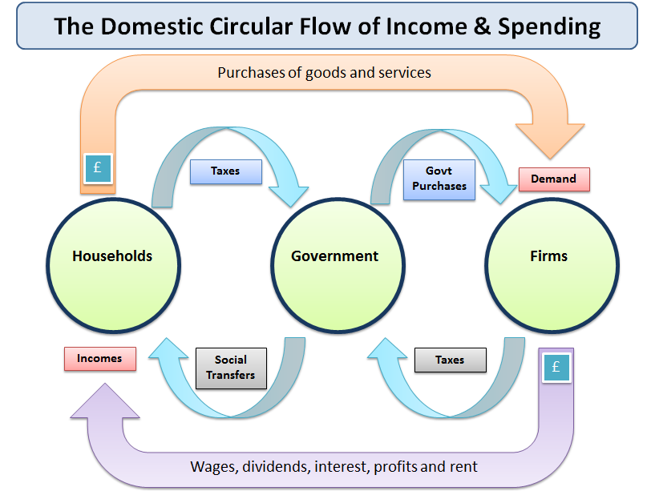

Slide 7
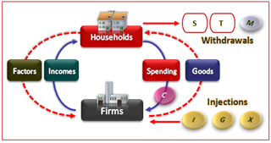
Withdrawals and Injections

Slide 8
Key Concepts
Gross Domestic Product (GDP)
  The monetary value of all goods and services produced within the SL in a given time period
Real GDP
  The volume of goods and services produced within the SL (i.e. GDP adjusted for changes in the price level)
Economic Growth
  The percentage rate of increase of real GDP
Inflation
  The annual percentage rate of change of the general price level

Slide 9
Difference between micro & macro
Microeconomics
Recession in the tourist industry due to the global downturn
A government subsidy to milk producers
A recession in the textiles industry
Increased spending on the National Health Service

Slide 10
Difference between micro & macro
Macroeconomics
Strong economic growth arising from high levels of consumer spending
A fall in exports because of a recession in leading European markets
Higher interest rates to control inflationary pressure

Slide 11

Objectives of economic policy
What are the government’s main economic objectives?

Slide 12
Targets, Instruments and goals of
Macroeconomics policy
Policy target
Policy Instrument
Policy Goals
The Exchange rate The Monetary Supply Aggregated Demand Real GDP Growth Budget Deficit | Monitory Policy Fiscal Policy Supply Side policy Exchange Control | Stable Prices Full Employment Sustained Growth Rising Living Standards Poverty Alleviation Product Efficiency

Slide 13
The main objectives of government economic policy
The key elements of the Government's strategy are:
Delivering macroeconomic stability (a very broad macroeconomic aim)
Meeting the productivity challenge (an important supply-side target)
Increasing employment opportunity for all (a labour market objective)
Ensuring fairness for families and communities (commitment to equity)
Protecting the environment (green economics has a macroeconomic dimension)

Slide 14
Macro stability…
What are the government’s main economic objectives?
Low inflation
Steady and sustained growth
High levels of employment
Improvements in living standards

Slide 15
Macro stability can be measured by the volatility of key indicators:
Consumer price inflation (annual % change in prices)
2. Real GDP growth over one or more business cycles
3. Changes in measured unemployment / employment
4. Fluctuations in the current account of the balance of payments
5. Changes in government finances (i.e. the size of the fiscal deficit or surplus)
6. Volatility of short term policy interest rates and long term interest rates such as the yield on government bonds
7. Stability of the exchange rate in currency markets

Slide 16
What makes a stable economy? Ctd…
A stable economy provides a framework for an improved supply-side performance i.e.
• Stable low inflation encourages higher investment which is a determinant of improved productivity and non-price competitiveness
• Control of inflation helps to main price competitiveness for exporters and domestic businesses facing competition from imports

Slide 17
What makes a stable economy? Ctd……..
• Stability breeds higher levels of consumer and business confidence – sentiment drives spending in the circular flow
• The maintenance of steady growth and price stability helps to keep short term and long term interest rates low, important in reducing the debt-servicing costs of people with mortgages and businesses with loans to repay
• A stable real economy helps to anchor stable expectations and this can act as an incentive for an economy to attract inflows of foreign direct investment(FDI)

Slide 18
Measuring National Income

Slide 19
What is National Income?
National income measures the total value of goods and services produced within the economy over a period of time
National Income can be calculated in three main ways
1. The sum of factor incomes earned in production
2. Aggregate demand for goods and services(expenditure method)
3. The sum of value added from each productive sector of the economy
Notes:
There are there three main methods of calculating a country’s national income (Y):
Income method adds up the factor incomes earned from the current production of goods and services
Expenditure method adds up the money spent on all current finished goods and services, less the cost of imports (AD= C+I+G+X-M)
Output method adds up the value of final current UK output. Intermediate output is ignored and value added (output less cost of inputs) is counted

Slide 20
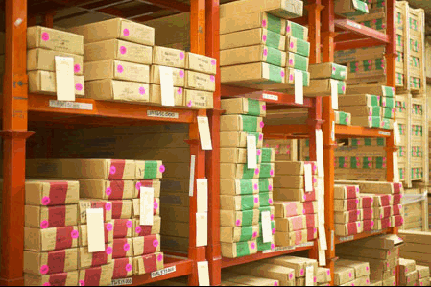

Why is national income important?
Measuring the level and rate of growth of national income (Y) is important to economists when they are considering:
  Economic growth and where a country is in the business cycle
  Changes to average living standards of the population
  Looking at the distribution of national income (i.e. measuring income and wealth inequalities)

Slide 21
Gross Domestic Product (GDP)
GDP measures the value of output produced within the domestic boundaries of the Sri Lanka
GDP includes the output of the foreign owned firms with production plants located in the Sri Lanka
There are three ways of calculating GDP - all of which should sum to the same amount since by identity:
National Output = National Expenditure = National Income
Under the new definitions introduced in 1998, GDP is now known as Gross Valued Added

Slide 22
Expenditure approach(GNE) | Income based approach(GNI)
Consumption expenditure by households | Wages
Investment expenditure by businesses | Rent
Government purchases of goods & services | Profits
Capital Investments | Interest
In theory, the three must yield the same, because total expenditures on goods and services(GNE) must equal the total income paid to the producers(GNI), that must also equal the total value of the output of goods and services(GNP).

Slide 23
Aggregate Demand (AD)
AD is the sum of the final expenditure on SL produced goods and services measured at current market prices
The full equation for GDP using this approach is
GDP = C + I + G + (X-M)
C: Household spending (consumption)
I: Capital Investment spending
G: General Government spending
X: Exports of Goods and Services
M: Imports of Goods and Services

Slide 24
How GNP is calculated
There are various ways of calculating GNP numbers.
Expenditure Approach to calculating GNP
GNP = GDP + NR (Net factor income)

Slide 25
Demand Side shocks
Lots of unexpected events can happen which cause changes in the level of demand, output and employment in the economy. These unplanned events are called “shocks” One of the causes of fluctuations in the level of economic activity is the presence of demand-side shocks.

Slide 26
Some of the main causes of demand-side shocks are as follows:
A capital investment boom e.g. a construction boom to increase the supply of new houses or to build new commercial and industrial buildings.
A rise or fall in the exchange rate – affecting net export demand and having follow-on effects on output, employment, incomes and profits of businesses linked to export industries.
A large boom in the housing market or a slump in share prices.
An unexpected cut or an unexpected rise in interest rates.

Slide 27
Why does the AD curve slope downwards?
There are several explanations for an inverse relationship between aggregate demand and the price level in an economy. These are summarized below:
Falling real incomes: As the price level rises, so the real value of people’s incomes fall and consumers are then less able to afford SL produced goods and services.
The balance of trade: As the price level rises, foreign-produced goods and services become more attractive (cheaper) in price terms, causing a fall in exports and a rise in imports. This will lead to a reduction in trade (X-M) and a contraction in aggregate demand.
Interest rate effect: if in the SL the price level rises, this causes an increase in the demand for money and a consequential rise in interest rates with a deflationary effect on the entire economy. This assumes that the central bank (in our case the Bank of SL) is setting interest rates in order to meet a specified inflation target.

Slide 28
Shifts in the AD curve
A change in factors affecting any one or more components of aggregate demand, households (C), firms (I), the government (G) or overseas consumers and business (X) changes planned aggregate demand and results in a shift in the AD curve.

Slide 29
Supply-side Policies
The “supply side” refers to factors affecting the quantity or quality of goods and services produced by an economy such as the level of productivity or investment in research and development.

Slide 30
Supply Side Policies for Product Markets
Privatization
Deregulation of Markets
Toughening up of Competition Policy
A commitment to free international trade
Measures to encourage small business start-ups / entrepreneurship
Capital investment and innovation:
Innovation and Economic Growth

Slide 31
Supply side policies for the Labour Market
Trade Union Reforms
Increased Spending on Education and Training
Income Tax Reforms and the Incentive to Work

Slide 32
GDP by Factor Income
GDP is the sum of the final incomes earned through the production of goods and services
The main factor incomes are as follows:
  Income from employment and self-employment
  Profits of commercial companies
  Rental income from the ownership of property
  Interest earned for capital employment
= Gross Domestic product (by factor income)

Slide 33
GDP by Factor Income…cont
Only factor incomes generated through the output of goods and services are included in the calculation of GDP by the income
We exclude from the accounts:
  Transfer payments (e.g. the state pension, income support and the Jobseekers’ Allowance)
  Private transfers of money from one individual to another
  Income that is not registered with the Inland Revenue
  There is a sizeable shadow economy in which income and spending is generated but no tax is declared

Slide 34

Welfare benefits
Welfare benefits are excluded from the income approach to calculating national income
This is because welfare benefits are simply transfers rather than a reward for factors of production

Slide 35
GDP by Value Added from each Sector
This measures the value of output produced by each industry using the concept of value added
Value added is the difference between the value of goods as they leave a stage of production and the cost of the goods as they entered that stage
We use this approach to avoid the problems of double-counting the value of intermediate inputs
We try to calculate the value added at each stage of the supply chain
This is difficult when production is complex

Slide 36
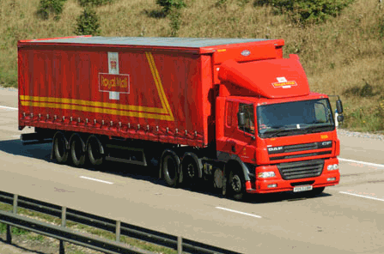
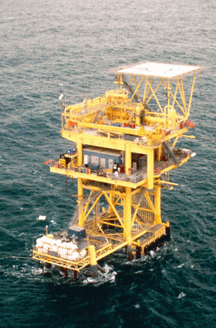
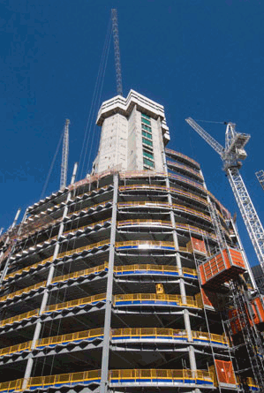
Sectors of the economy

Slide 37
GDP and GNP
Gross National Product (GNP) measures the final value of output or expenditure by SL owned factors of production whether they are located in the SL or overseas
GNP = GDP + Net property income from abroad (NPIA)
NPIA is the net balance of interest, profits and dividends (IPD) coming into the SL from SL assets owned overseas matched against the flow of profits and other income from foreign owned assets located within the SL
Notes:
Gross National Product (GNP) measures the value of output produced by UK citizens anywhere in the world, in a given period of time. Eg: cars produced by Honda or Toyota in the UK are included in UK GDP but the profits sent back to Japan add to Japan’s GNP. For the UK, our GNP exceeds our GDP because we have a net flow of investment income coming into the country from our overseas assets. In 2001 the net value of investment income for the UK was £12.6 billion
GNP = GDP + net property income from abroad (NPIA) ie income received from other countries (eg interest and dividends), less similar payments made to other countries

Slide 38
GDP and GNP
GDP is the value of output produced by factors of production located within a country
Output produced by a country’s citizens, regardless of where the output is produced, is measured by gross national product (GNP)

Slide 39
Limitations of national income data
Non-marketed output e.g. value of housework and voluntary activities are not yet part of official NY figures
Undeclared economic activity eg shadow or informal economy is excluded from official NY figures
Transfer payments are excluded ie benefit payments received with no corresponding output eg unemployment and child benefits
Double counting. In the output method of calculating GDP we ignore intermediate output and count only value added – but this is done by using a sample of firms from each industry and calculating value added can be difficult to estimate

Slide 40
Shadow economy….
GDP underestimates value added in the construction industry, second hand cars and personal services eg home help.
The shadow economy has grown very rapidly over the last thirty years and it is a phenomenon that is common to many countries

Slide 41
GDP and the standard of living
Once GNP has been calculated it is
  Converted into US dollars at the official exchange rate
  Divided by the country population
This gives an average figure for GNP per head/ GNP per capita
The standard of living refers to the amount of goods and services consumed by households in one year and is found by applying the equation:
  Standard of living = Real national income/Population
A high standard of living means households consume a large number of goods and services

Slide 42
Human Development Index
A new way of measuring development by combining indicators of life expectancy, educational attainment and income into a composite human development index, the HDI. The breakthrough for the HDI was the creation of a single statistic which was to serve as a frame of reference for both social and economic development.

Slide 43
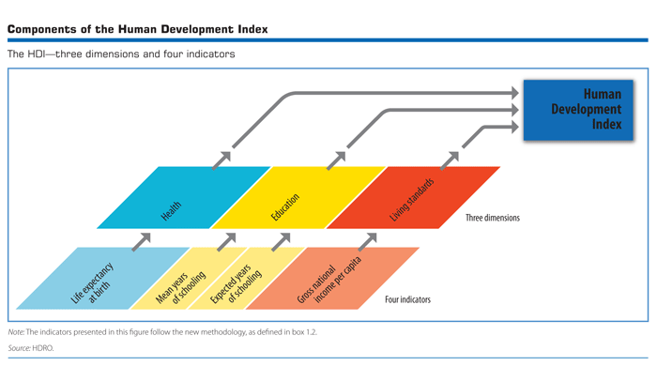
HDI – Human Development Index

Slide 44
Measuring Income distribution equality among nations
Refer Lorenz curve and Gini coefficient additional reading

Slide 45
GINI index in Sri Lanka
Gini index measures the extent to which the distribution of income (or, in some cases, consumption expenditure) among individuals or households within an economy deviates from a perfectly equal distribution. A Lorenz curve plots the cumulative percentages of total income received against the cumulative number of recipients, starting with the poorest individual or household.
The Gini index measures the area between the Lorenz curve and a hypothetical line of absolute equality, expressed as a percentage of the maximum area under the line. Thus a Gini index of 0 represents perfect equality, while an index of 100 implies perfect inequality.

Slide 46
Economic growth
Economic growth is best defined as a long-term expansion of the productive potential of the economy. Sustained economic growth should lead higher real living standards and rising employment. Short term growth is measured by the annual % change in real GDP.

Slide 47
Advantages of Economic Growth
Sustained economic growth is a major objective of government policy – not least because of the benefits that flow from a growing economy.
Higher Living Standards – for example measured by an increase in real national income per head of population – see the evidence shown in the chart below
Employment effects: Growth stimulates higher employment.
Fiscal Dividend: Growth has a positive effect on government finances - boosting tax revenues and providing the government with extra money to finance spending projects
The Investment Accelerator Effect: Rising demand and output encourages investment in new capital machinery – this helps to sustain the growth in the economy by increasing long run aggregate supply.
Growth and Business Confidence: Economic growth normally has a positive impact on company profits & business confidence – good news for the stock market and also for the growth of small and large businesses alike

Slide 48
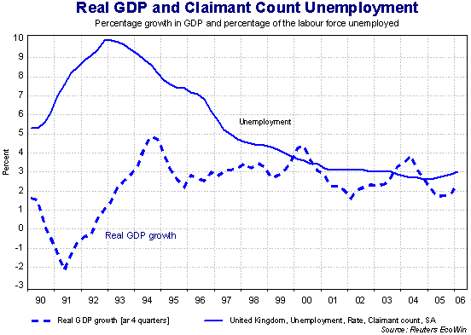
has certainly been the case for the British economy over the last decade.

Slide 49
Disadvantages of economic growth
There are some economic costs of a fast-growing economy. The two main concerns are firstly that growth can lead to a pick up in inflation and secondly, that growth can have damaging effects on our environment, with potentially long-lasting consequences for future generations.
Inflation risk: If the economy grows too quickly there is the danger of inflation as demand races ahead of aggregate supply. Producer then take advantage of this by raising prices for consumers
Environmental concerns: Growth cannot be separated from its environmental impact. Fast growth of production and consumption can create negative externalities (for example, increased noise and lower air quality arising from air pollution and road congestion, increased consumption of de-merit goods, the rapid growth of household and industrial waste and the pollution that comes from increased output in the energy sector) These externalities reduce social welfare and can lead to market failure. Growth that leads to environmental damage can have a negative effect on people’s quality of life and may also impede a country’s sustainable rate of growth.

Slide 50
The END

